Slide 1

Nondestructive Forensics
Debugging K8s Services Without Disturbing State
Alex Leong

Slide 2
“We replaced our monolith with micro services so that every outage could be more like a murder mystery.”
— @honest_update, Oct 7, 2015
Notes:
This metaphor is very apt: often to root cause an outage, we have to gather clues
from the production environments (logs, metrics, etc), consider the suspects,
and mentally reconstruct what we think happened. It’s very much like detective work.

Slide 3


Alex Leong
Software Engineer @ Buoyant
🔧
Linkerd Maintainer
Board Game Aficionado
Microservices Detective
🎲
🕵️

Slide 4

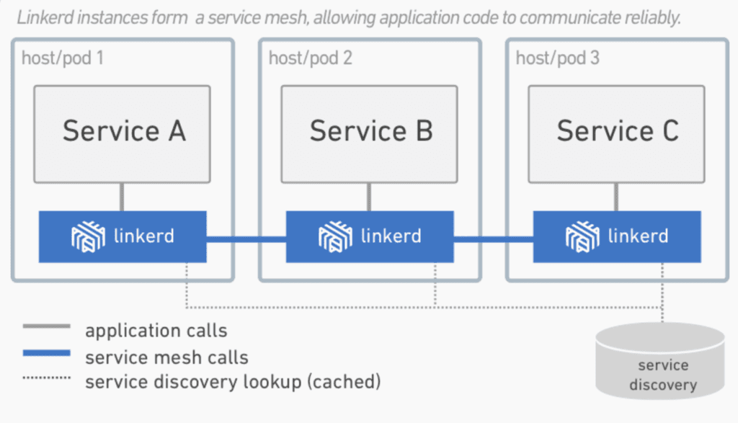

An open source service mesh and CNCF incubating project.
Open Governance
Ultralight
Security-first
Go and Rust
Notes:
Linkerd runs a sidecar proxy in each pod that handles all incoming and outgoing traffic for that pod.
Since Linkerd handles all network traffic, it’s critical that it doesn’t have any bugs that impact that traffic
One of the most interesting things that I get to do is investigate bug reports because it means I get to do detective work

Slide 5
Agenda
🔍 Why is “detective work” hard?
🚦 Linkerd Tap
👾 Debug sidecars
⚡️ Direct Node Access
🚀 What even is a pod anyway?
🏗 Ephemeral Containers
Notes:
I hope some of these tools will be useful to you when doing your own microservice debugging
Or at least you’ll learn about how pods and network namespaces work in Kubernetes

Slide 6
Reproducing Bugs
tt

Slide 7

Reproducing Bugs
Some bugs are difficult to reproduce
They may only occur:
In certain environments
At certain load levels
After a certain amount of time
When Mercury is in retrograde
Notes:
Not unique to Linkerd

Slide 8

Reproducing Bugs
Collect as much data as possible!
Avoid:
Restarting the process
Restarting the pod
Interrupting connections
Disturbing the scene of the crime
Non-destructive forensics

Slide 9

Reproducing Bugs
Reproducing Bugs
Focus on bugs in service to service communication
This is where I have experience
Essential to microservices
Hard to debug
Lets us identify the culprit

Slide 10
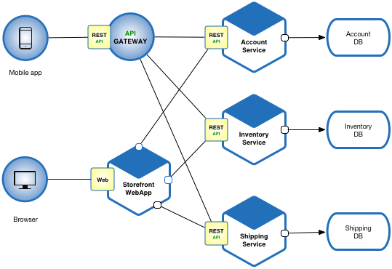
Reproducing Bugs
Reproducing Bugs
Each service has a contract
Look at communication to see who is violating their contract
Application level
Network level

Slide 11
Linkerd Tap
tt

Slide 12
Linkerd Tap
Tap into any HTTP stream
View requests and responses
Real-Time
Authorization using RBAC

Slide 13
Linkerd Tap
> linkerd tap -n emojivoto deploy/web
req id=1:1 proxy=out src=10.8.4.10:51992 dst=10.8.4.9:8080 tls=true :method=POST :authority=emoji-svc.emojivoto:8080 :path=/emojivoto.v1.EmojiService/ListAll
rsp id=1:1 proxy=out src=10.8.4.10:51992 dst=10.8.4.9:8080 tls=true :status=200 latency=1832µs
end id=1:1 proxy=out src=10.8.4.10:51992 dst=10.8.4.9:8080 tls=true grpc-status=OK duration=61µs response-length=2140B

Slide 14
Linkerd Tap
> linkerd tap -n emojivoto deploy/web
req id=1:1 proxy=out src=10.8.4.10:51992 dst=10.8.4.9:8080 tls=true :method=POST :authority=emoji-svc.emojivoto:8080 :path=/emojivoto.v1.EmojiService/ListAll
rsp id=1:1 proxy=out src=10.8.4.10:51992 dst=10.8.4.9:8080 tls=true :status=200 latency=1832µs
end id=1:1 proxy=out src=10.8.4.10:51992 dst=10.8.4.9:8080 tls=true grpc-status=OK duration=61µs response-length=2140B

Slide 15
Linkerd Tap
> linkerd tap -n emojivoto deploy/web
req id=1:1 proxy=out src=10.8.4.10:51992 dst=10.8.4.9:8080 tls=true :method=POST :authority=emoji-svc.emojivoto:8080 :path=/emojivoto.v1.EmojiService/ListAll
rsp id=1:1 proxy=out src=10.8.4.10:51992 dst=10.8.4.9:8080 tls=true :status=200 latency=1832µs
end id=1:1 proxy=out src=10.8.4.10:51992 dst=10.8.4.9:8080 tls=true grpc-status=OK duration=61µs response-length=2140B

Slide 16
Linkerd Tap
> linkerd tap -n emojivoto deploy/web
req id=1:1 proxy=out src=10.8.4.10:51992 dst=10.8.4.9:8080 tls=true :method=POST :authority=emoji-svc.emojivoto:8080 :path=/emojivoto.v1.EmojiService/ListAll
rsp id=1:1 proxy=out src=10.8.4.10:51992 dst=10.8.4.9:8080 tls=true :status=200 latency=1832µs
end id=1:1 proxy=out src=10.8.4.10:51992 dst=10.8.4.9:8080 tls=true grpc-status=OK duration=61µs response-length=2140B

Slide 17
Linkerd Tap
> linkerd tap -n emojivoto deploy/web
req id=1:1 proxy=out src=10.8.4.10:51992 dst=10.8.4.9:8080 tls=true :method=POST :authority=emoji-svc.emojivoto:8080 :path=/emojivoto.v1.EmojiService/ListAll
rsp id=1:1 proxy=out src=10.8.4.10:51992 dst=10.8.4.9:8080 tls=true :status=200 latency=1832µs
end id=1:1 proxy=out src=10.8.4.10:51992 dst=10.8.4.9:8080 tls=true grpc-status=OK duration=61µs response-length=2140B

Slide 18
Linkerd Tap
> linkerd tap -n emojivoto deploy/web
req id=1:1 proxy=out src=10.8.4.10:51992 dst=10.8.4.9:8080 tls=true :method=POST :authority=emoji-svc.emojivoto:8080 :path=/emojivoto.v1.EmojiService/ListAll
rsp id=1:1 proxy=out src=10.8.4.10:51992 dst=10.8.4.9:8080 tls=true :status=200 latency=1832µs
end id=1:1 proxy=out src=10.8.4.10:51992 dst=10.8.4.9:8080 tls=true grpc-status=OK duration=61µs response-length=2140B

Slide 19
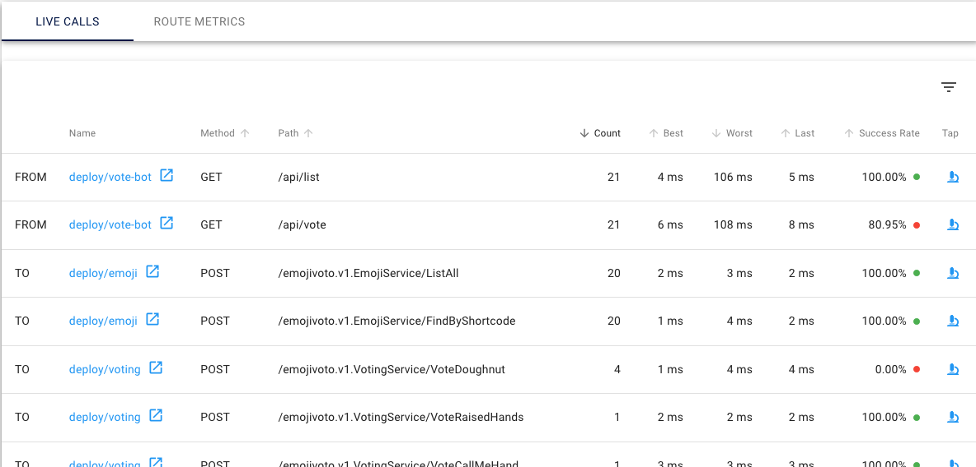
Linkerd Tap

Slide 20
Linkerd Tap
Pros:
Extremely convenient
Rich request/response metadata
Non-destructive
Cons:
Requires Linkerd
No message bodies (yet)
HTTP/gRPC only

Slide 21
Debug Sidecar
tt

Slide 22
Debug Sidecar
Powerful network debugging tools already exist:
netstat, ss, tcpdump, wireshark, tshark, dig, curl, nghttp
But might not exist in the container
Debug sidecar:
Container with debugging tools
Run in the application’s pod
Shares a network namespace

Slide 23
Debug Sidecar
Connections
Pod (10.8.4.10)
Application Container
kubectl exec /bin/bash
Debug Container

Slide 24
Debug Sidecar
> linkerd inject emojivoto.yml --enable-debug-sidecar \
| kubectl apply -f -
> kubectl -n emojivoto exec -it deploy/web \
-c linkerd-debug /bin/bash
root@web-58f5677bdf-hxnwl:/# tcpdump

Slide 25
Debug Sidecar
Pros:
Powerful low-level tools
Doesn’t strictly require Linkerd
Cons:
Destructive: Requires restarting the pod

Slide 26
Direct Node Access
tt

Slide 27

Direct Node Access
Want to use powerful debugging tools
Don’t want to restart the pod
What if we SSH to the node?

Slide 28
Direct Node Access
Pod (10.8.4.10)
Application Container
Debug Container

Slide 29
Direct Node Access
Node
Pod
Pod
Pod
Container
Container
Container
Pod
Pod
Container
Container

Slide 30
Direct Node Access
Node
Docker
Container
Container
SSH
Container
Container
Container

Slide 31
Direct Node Access
nsenter
execute a command in a given network namespace
nsenter -t <pid> -n tcpdump

Slide 32
Direct Node Access
> docker ps
CONTAINER ID IMAGE COMMAND CREATED STATUS PORTS NAMES
4fa0730eb40c buoyantio/emojivoto-web "/bin/sh -c 'cd /usr…" 32 minutes ago Up 32 minutes […]
…
> docker inspect --format '{{ .State.Pid }}' 4fa0730eb40c
10397
> nsenter -t 10397 -n tcpdump

Slide 33
Direct Node Access
Pros:
Powerful low-level tools
Non-desctructive
Cons:
Requires node SSH access
Somewhat complex

Slide 34
Ephemeral Containers
tt

Slide 35
Ephemeral Containers
Alpha feature as of Kubernetes 1.16
Add a container to a running pod without restarting it
Best of all worlds:
Powerful low-level tools
Easy to use
Non-destructive
> kubectl alpha debug -it web-58f5677bdf-hxnwl --image=gcr.io/linkerd-io/debug --target=web-svc

Slide 36
Summary
🔍 Network debugging is hard but good tools exist
🚦 Linkerd Tap • For high-level HTTP debugging
👾 Debug sidecars • If you plan ahead
⚡️ Direct Node Access • If all else fails
🏗 Ephemeral Containers • In the glorious future

Slide 37





Join our community!
github.com/linkerd
slack.linkerd.io
@linkerd
F R O M Y O U R F R I E N D S A T

